Slide 1

EG3611A Final Presentation 05/06/2020

Slide 2
Topics Covered
Context of problem to be explored/solved
Introduction on Machine Learning
Choosing Machine Learning library
Data Collection
Applications of Machine Learning

Slide 3
Context of problem to be explored
Description of my project
Placement and Routing

Slide 4
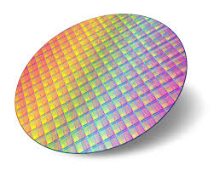
Placement and Routing
Design Specifications
Floorplanning
Placement
Clock Tree Synthesis
Routing
Design Rule Check
Layout VS Schematic

Slide 5
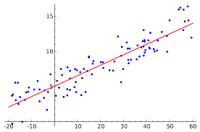
Description of Project
Title: Place and Route Regression Prediction using Machine Learning
Objective: Reduce the cost of regression by the use of machine learning techniques

Slide 6
Introduction on Machine Learning
Introduction on Machine Learning
Types of Machine Learning
Feasibility criteria of Machine Learning

Slide 7
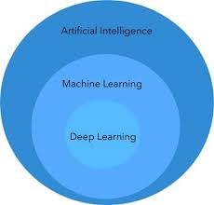
Introduction on Machine Learning

Slide 8
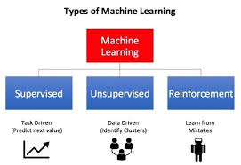
Types of Machine Learning

Slide 9
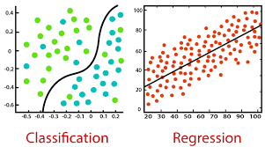
Types of Supervised Learning Techniques

Slide 10
Feasibility of Machine Learning
Requires prediction or bucketing something into categories
Relatively self-contained (not much noise/ additional factors)
Have labelled data available
Ability to access quality of model
Determine acceptable accuracy threshold
More training data -> Better accuracy of model

Slide 11
Choosing suitable ML library
Introduction on scikit-learn and TensorFlow
Main Differences
Criteria for choosing suitable Machine Learning library

Slide 12
Criteria for choosing ML library
Free, Open Source
Smooth implementation and integration
Reduced time to code and debug
Exhaustive library: solution for any existing problem

Slide 13
Introduction on scikit-learn
Free, Open Source machine learning library
Scikit -> SciPy ToolKit
Designed to interoperate with NumPy and SciPy
Algorithms: Classification, Regression, Clustering

Slide 14
Introduction on TensorFlow
Free, Open Source machine learning library
Developed by Google Brain team for internal use
Released under an open source license in 2015
Uses dataflow graphs (nodes and edges)

Slide 15
Main Differences
scikit-learn | TensorFlow
High-level framework | Low-level framework
Supervised/Unsupervised Learning | Deep Learning
Requires low hardware requirement (CPU) | Requires high hardware requirement (GPU)

Slide 16
Data Collection
Flow and Rundown of Script Code
Demonstration of Script

Slide 17
Flow of Script Code
Import relevant libraries
Funcions to get data from Place and Route log files
Append data from both functions
Write results to csv file
Delete duplicate rows

Slide 18
Applications of ML in PnR
Flow and Rundown of Machine Learning Code
Limitations and Possible Improvements
Demonstration of ML Code
Possible Applications

Slide 19
Possible Applications
Predict Run Time of Placement and Routing
Predict Width and Height of Required Floorplan
Predict Violations and Antenna Violations

Slide 20
Flow of Machine Learning Code
Import relevant libraries and dataset
Define features and targets
Standardize data to a normal distribution
Split dataset into train and test sets, leaving out outliers
Find best regression model from scikit-learn using cross validation and feature selection
Tune model’s hyperparameters with GridSearchCV
Test out best model with tuned hyperparameters on test set

Slide 21
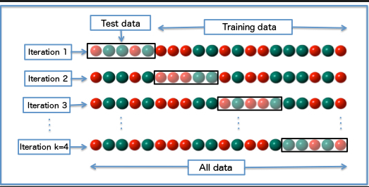
K-fold Cross Validation

Slide 22
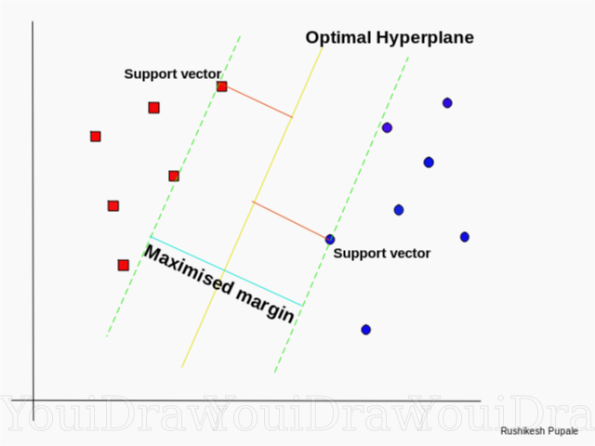
Support Vector Machine

Slide 23
Results of RunTime Prediction
Root Mean Squared Error
RunTimeRoute: 0.51
RunTimePlace: 1.15

Slide 24
Results of RunTime Prediction
RunTimeRoute:
RunTimePlace:
Actual/ Predicted | Failure | Success
Failure | 0 | 3
Success | 0 | 18
Actual/ Predicted | Failure | Success
Failure | 0 | 0
Success | 0 | 21

Slide 25
Results of Prediction of Width and Height of Required Floorplan
Root Mean Squared Error
CoreWidth: 0.0337
CoreHeight: 0.405

Slide 26
Limitations and Possible improvements
Lack of data points in dataset
Lack of variance in dataset for certain columns
Tweak number of folds in k-fold cross validation and GridSearchCV
Use data only known before regression takes place
Eliminate possible sources of noise

